Slide 1
.

Slide 2




Control strategies
Helps us decide which rule to apply next.
What to do when there are more than 1 matching rules?
Good control strategy should:
cause motion 2.Systematic

Slide 3

Control strategies are classified as:
1. Uninformed/blind search control strategy
Do not have additional info about states beyond problem def.
Total search space is looked for solution
No info is used to determine preference of one child over other.
Example: 1. Breadth First Search(BFS), Depth First Search(DFS), Depth Limited Search (DLS).

Slide 4
E
B
A
D
F
H
C
G
State Space without any extra information associated with each state

Slide 5

2. Informed/Directed Search Control Strategy
Some info about problem space(heuristic) is used to compute preference among the children for exploration and expansion.
Examples: 1. Best First Search, 2. Problem Decomposition, A*, Mean end Analysis
Heuristic function:
It maps each state to a numerical value which depicts goodness of a node.
H(n)=value
Where ,
H() is a heuristic function and ‘n’ is the current state.

Slide 6
Ex: in travelling salesperson problem heuristic value associated with each node(city) might reflect estimated distance of the current node from the goal node.
The heuristic we use here is called HSLD Straight line Distance heuristic.

Slide 7

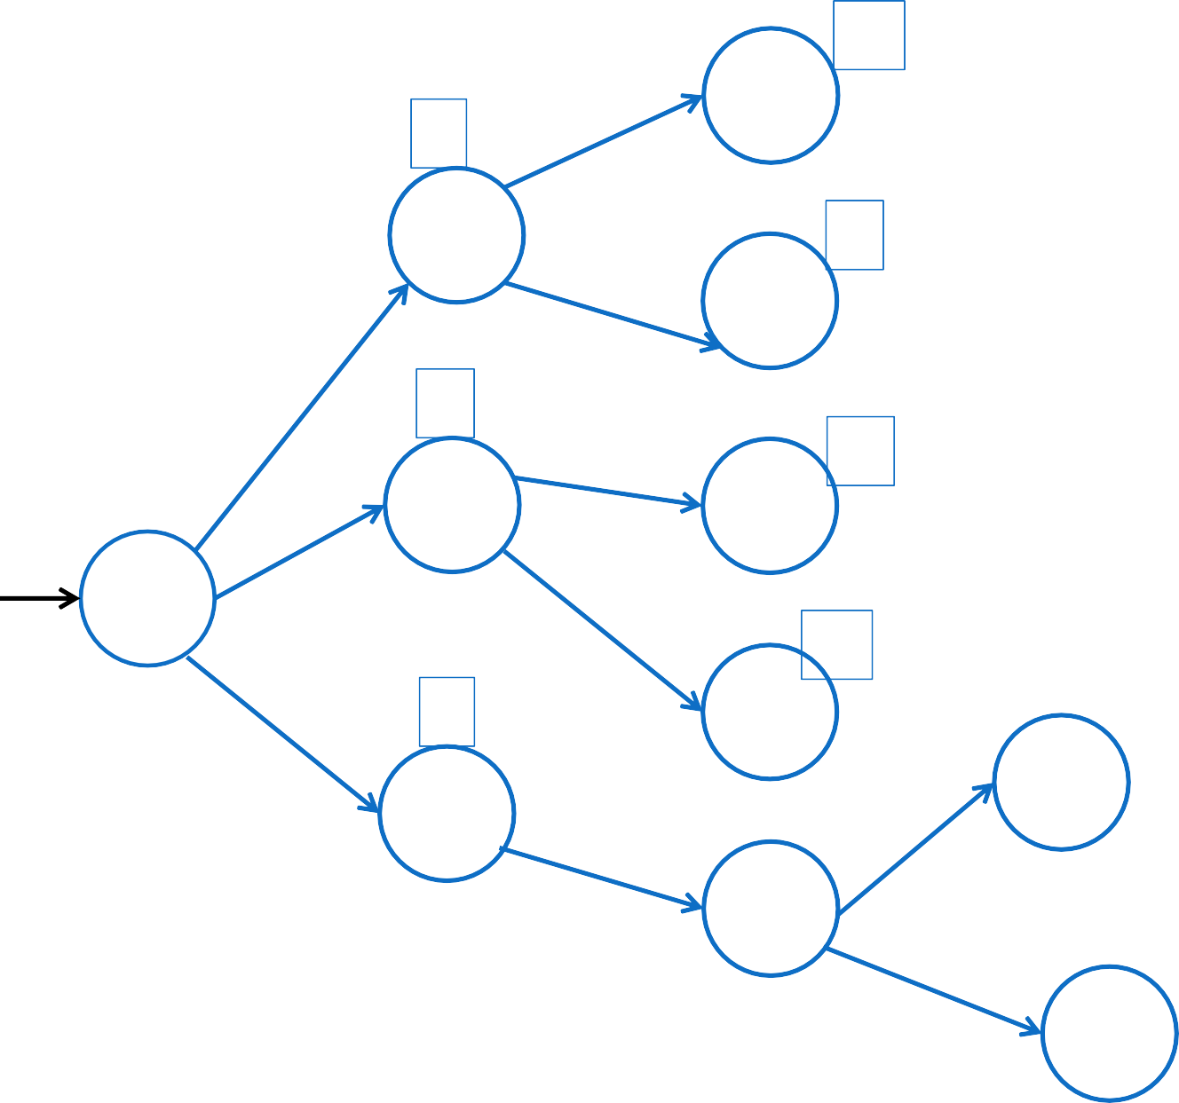
10
D
2
A
8
1
E
K
6
13
0
B
F
L
S
14
5
5
G
I
1
C
M
H
7
J
Example of the state space with heuristic values associated with each state

Slide 8
Breadth First Search (BFS)
Algorithm:
1. Create a variable NODE_LIST and set it to initial state.
2.Until a Goal State is found or NODE_LIST is empty:
A) Remove the first element from NODE_LIST amd call it as ‘E’. If the node list was empty then Quit.
B) For each way that each rule can match the state described in ‘E’ do:
i) Apply the rule to generate the new state
Ii) If the new state is a goal state, quit and return this
state.
Iii) otherwise add the new state at the end of NODE_LIST.

Slide 9
Consider the following State Space to be searched:
E
B
A
D
F
H
C
G
Let A be the start state and G be the final or goal state to be searched.
NODE_LIST={A}
A is not goal node it is expanded .

Slide 10

E
B
A
D
F
H
C
G
NODE_LIST={B,C}

Slide 11


E
B
A
D
F
H
C
G
NODE_LIST={C,D,E}

Slide 12

E
B
A
D
F
H
C
G
NODE_LIST={D,E,G}

Slide 13

E
B
A
D
F
H
C
G
NODE_LIST={E,G,F}

Slide 14

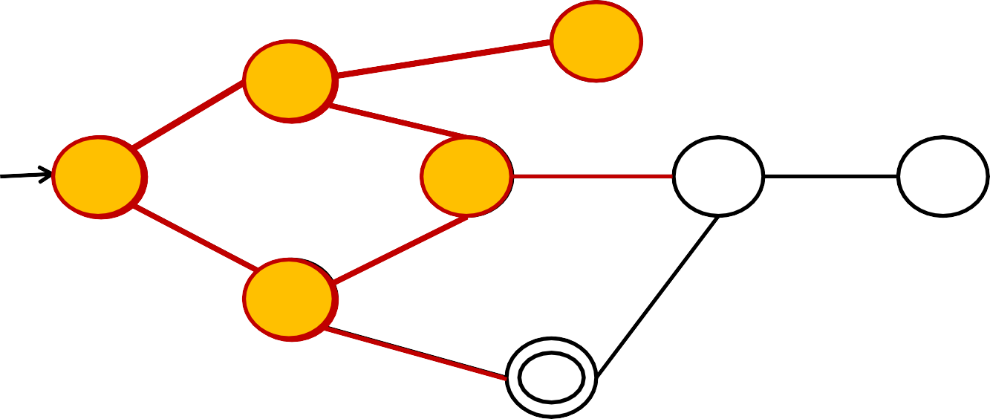
E
B
A
D
F
H
C
G
NODE_LIST={G,F}

Slide 15



E
B
A
D
F
H
C
G
NODE_LIST={G,F}
GOAL NODE FOUND!!

Slide 16

E
B
A
D
F
H
C
G
NODE_LIST={G,F}
TRAVERSAL ORDER:
A-B-C-D-E-G

Slide 17

Depth First Search
Algorithm:
If initial state is a goal state, quit and return success.
Otherwise do the following until success or failure is reported:
Generate successor ‘E’ of the initial state. If there are no more successors signal failure.
Call Depth-First-Search with ‘E’ as he start state. If there are no more successors then , signal failure.
If success is obtained, return success, otherwise continue in this loop.

Slide 18

Consider the following Search Space:
E
B
A
D
F
H
C
G
DFS(A)

Slide 19

Consider the following Search Space:
E
B
A
D
F
H
C
G
DFS(A)

Slide 20

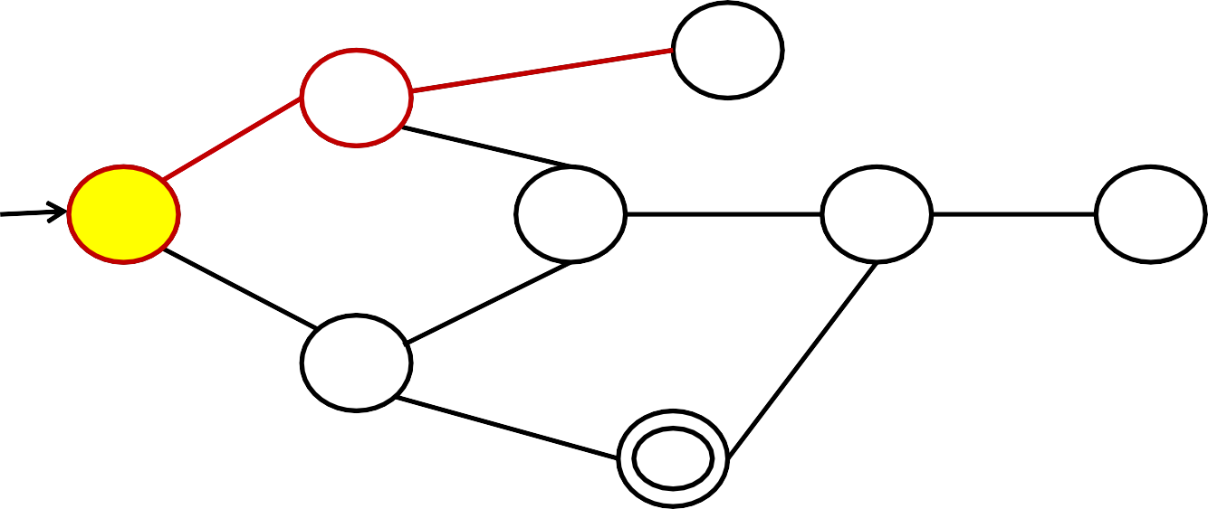
Consider the following Search Space:
E
B
A
D
F
H
C
G
DFS(B)

Slide 21
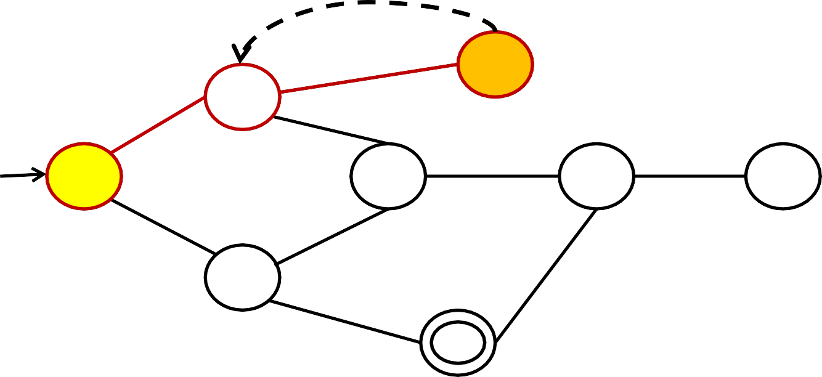
Consider the following Search Space:
E
B
A
D
F
H
C
G
DFS(E)

Slide 22
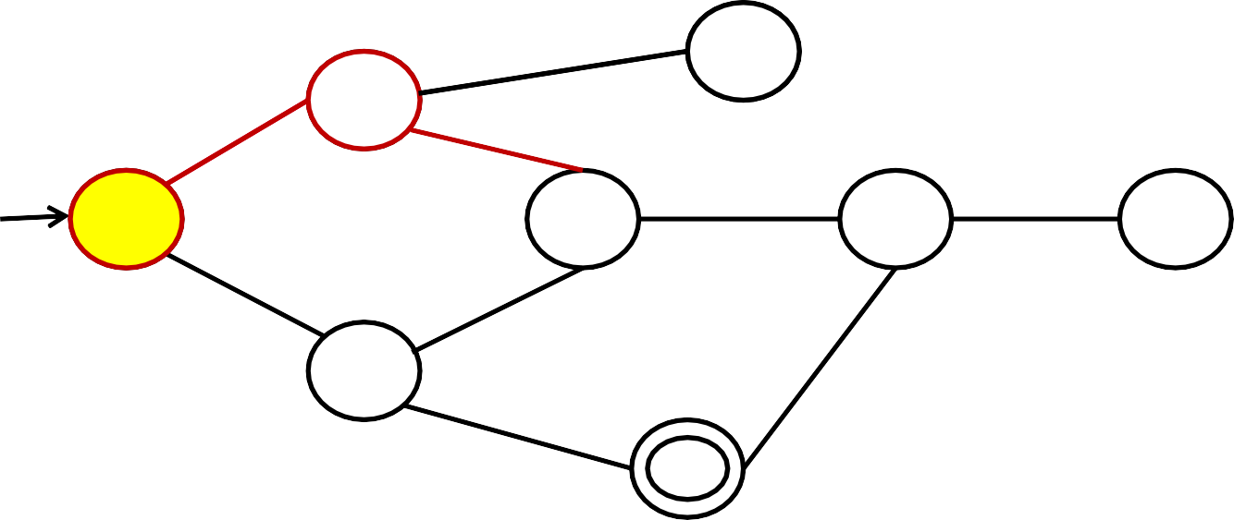
Consider the following Search Space:
E
B
A
D
F
H
C
G
DFS(B)

Slide 23

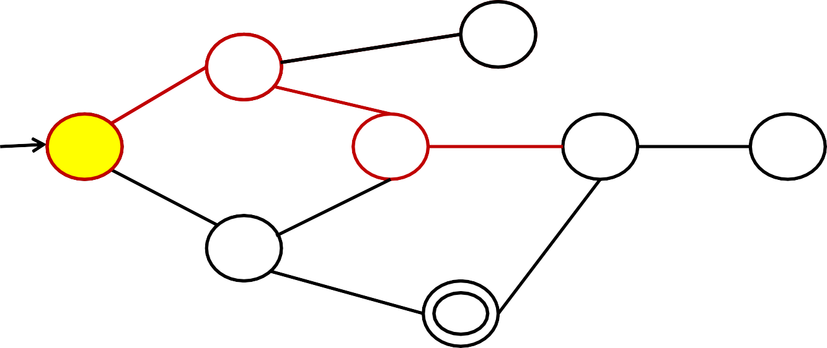
Consider the following Search Space:
E
B
A
D
F
H
C
G
DFS(D)

Slide 24
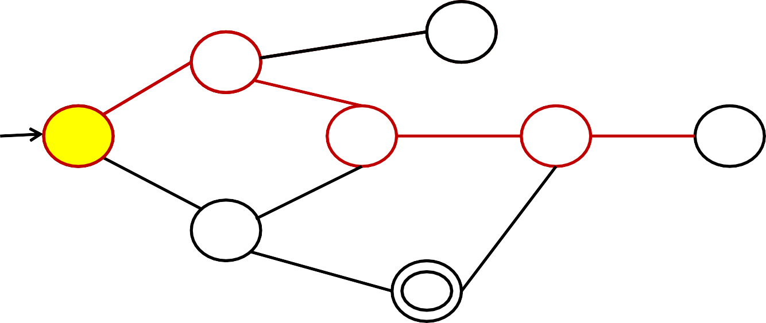
Consider the following Search Space:
E
B
A
D
F
H
C
G
DFS(F)

Slide 25
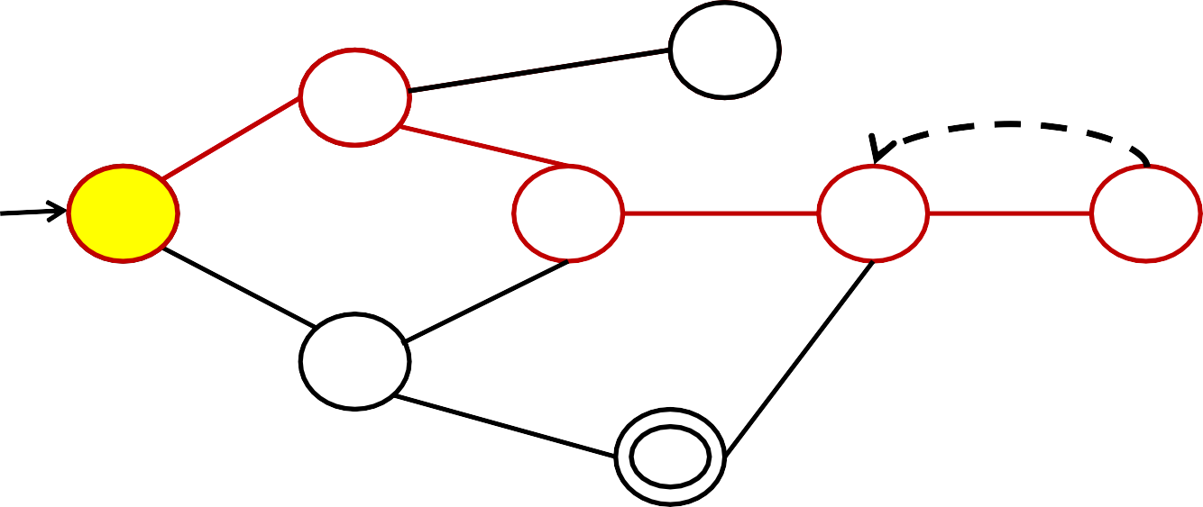
Consider the following Search Space:
E
B
A
D
F
H
C
G
DFS(H)

Slide 26
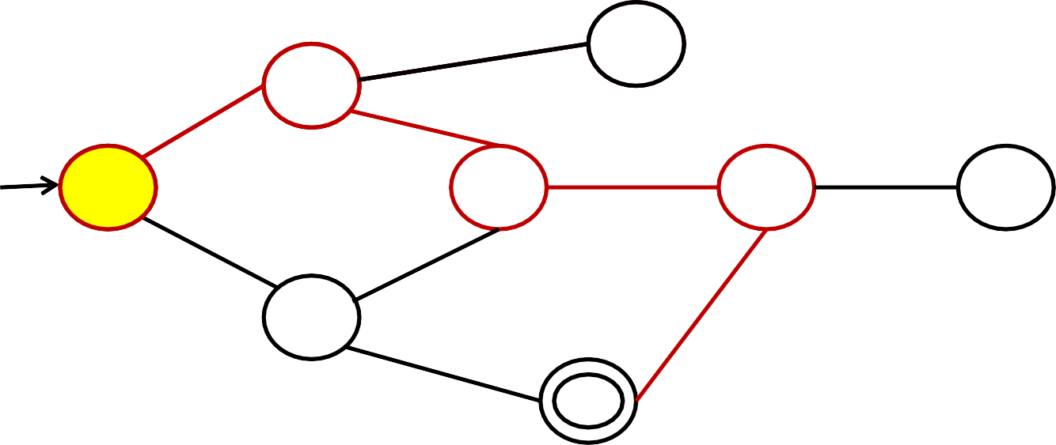
Consider the following Search Space:
E
B
A
D
F
H
C
G
DFS(F)

Slide 27
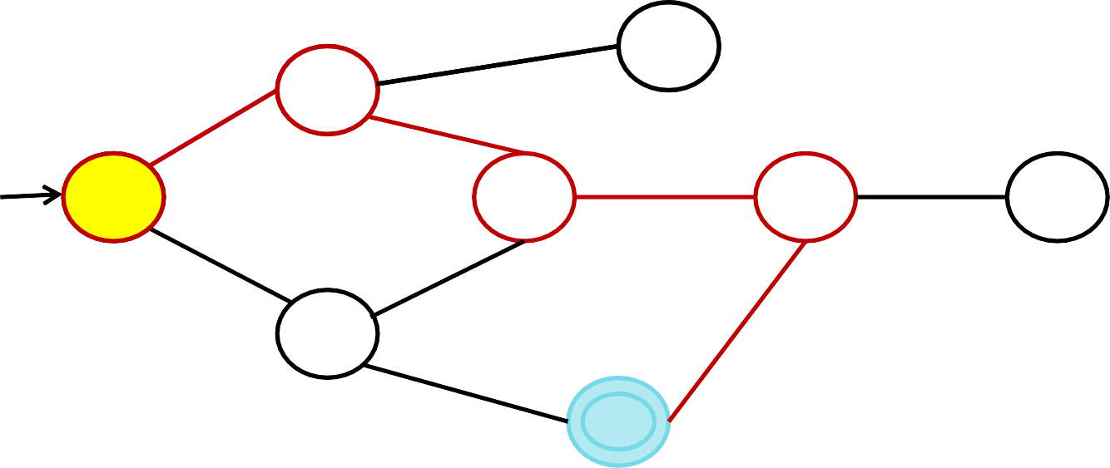
Consider the following Search Space:
E
B
A
D
F
H
C
G
DFS(G)
GOAL NODE FOUND!!

Slide 28

Advantages of BFS:
BFS is a systematic search strategy- all nodes at level n are considered before going to n+1 th level.
If any solution exists then BFS guarentees to find it.
If there are many solutions , BFS will always find the shortest path solution.
Never gets trapped exploring a blind alley
Disadvantages of BFS:
1.
All nodes are to be generated at any level. So even unwanted nodes are to be remembered. Memory wastage.
Time and space complexity is exponential type- Hurdle.
2.

Slide 29
Advantages of DFS:
Memory requirements in DFS are less compared to BFS as only nodes on the current path are stored.
DFS may find a solution without examining much of the search space of all.
Disadvantages of BFS:
1. This search can go on deeper and deeper into the search space and thus can get lost. This is referred to as blind alley.

Slide 30


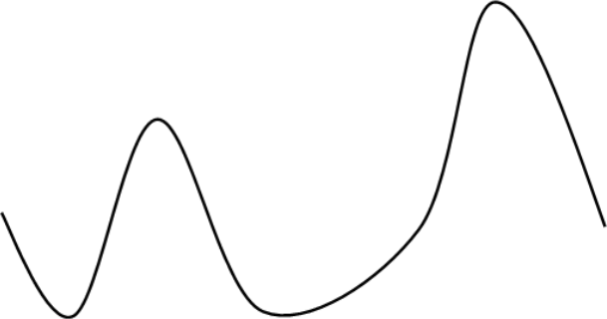

Hill Climbing Algorithm
Local Search Algorithm
State space landscape
Global Maximum
Y’
Local Maximum
Objective function
X’
P2’
P1’
Shoulder
P2 X
P1
Y
State space

Slide 31



Maximization function is called Objective Function
Minimization function is called Heuristic Cost function
Heuristic cost= distance, time, money spent
Objective function= profit, success
State space
HEURISTIC COST FUNCTION
Local Minimum
Global Minimum

Slide 32

Algorithm for Hill Climbing
Evaluate the initial state. If it is the goal state then return and quit. Otherwise continue with initial state as current state.
Loop until a solution is found or until there are no new operators left to be applied to the current state:
Select operator that has not been applied to the current state and apply it to produce the new state.
Evaluate the new state
If it is the goal state, then return and quit
ii. If it is not a goal state but it is better than the current state then make it the current state.
i.
iii. If it is not better than the current state then continue in the
loop.

Slide 33



Example block world problem:
1
HEURISTIC
FUNCTION- add one point for every block which is resting on the thing that it must be resting on.
1
1
1
1
1
1
1
1
1
1
1
INITIAL STATE (P)
GOAL STATE (Z)
H(P)=4
H(Z)=8

Slide 34


The tree generated till now is:
H(P)=4
p
From initial state most natural move is:
The tree Generated till Now is:
H(Q)= 6
H(P)=4
p
H(Q)=6
Q
STATE (Q)

Slide 35

















Now from Q there are three states possible which are as follows:
STATE (Q)
STATE (R) H(Q)= 6
STATE (S) H(Q)= 6
STATE (T)
H(Q)= 6

Slide 36
Thus we have the tree until now as:
H(P)=4
We see that from state Q When nodes R,S and T are Generated, their value of Heuristic is less compared To heuristic value of Q itself.
p
H(Q)=6
Q
Hill Climbing Algorithm Has reached local maxima
R
S
T
Whereas in reality the actual Goal node has heuristic value of 8.
H(R)=4
H(S)=4
H(T)=4
THIS IS A DISADVANTAGE
OF LOCAL SEARCH ALGORITHM!!

Slide 37

Advantages of Hill Climbing
It can be used in continuous as well as discrete domains.
Disadvantages of Hill Climbing
Not efficient method –not suitable to problems where the value of
heuristic function drops off suddenly when solution may be in sight.
Local search method- gets caught up in local maxima/minima.
Solution to Local Maxima problem:
Backtracking to some earlier node and try different direction.
Simulated annealing

Slide 38
Global Search Techniques:
1. Best First Search(OR graph)
Where not only the current branch of the search space but all the so far explored nodes/states in the search space are considered in determining the next best state/node.
2. A* Algorithm
Which is improvised version of Best first Search.
3. Problem Reduction and And-Or Graphs.
AO* Algorithm.
4. Constraint Satisfaction Problem (CSP)
Graph Colouring Problem and Crypt Arithmetic Problems.
5. Mean End Analysis (MEA)

Slide 39

Best First Search
Heuristic based search technique.
Every node in the search space has an Evaluation function (heuristic function)associated with it.
Evaluation function==heuristic cost function (in case of minimization problem) OR objective function(in case of maximization).
Decision of which node to be expanded depends on value of evaluation function.
Evaluation value= cost/distance of current node from goal node.
For goal node evaluation function value=0

Slide 40

Algorithm:
Uses 2 lists:
OPEN- all those nodes that have been generated & have had heuristic function applied to them but have not yet been examined.
CLOSED- contains all nodes that have already been examined.

Slide 41
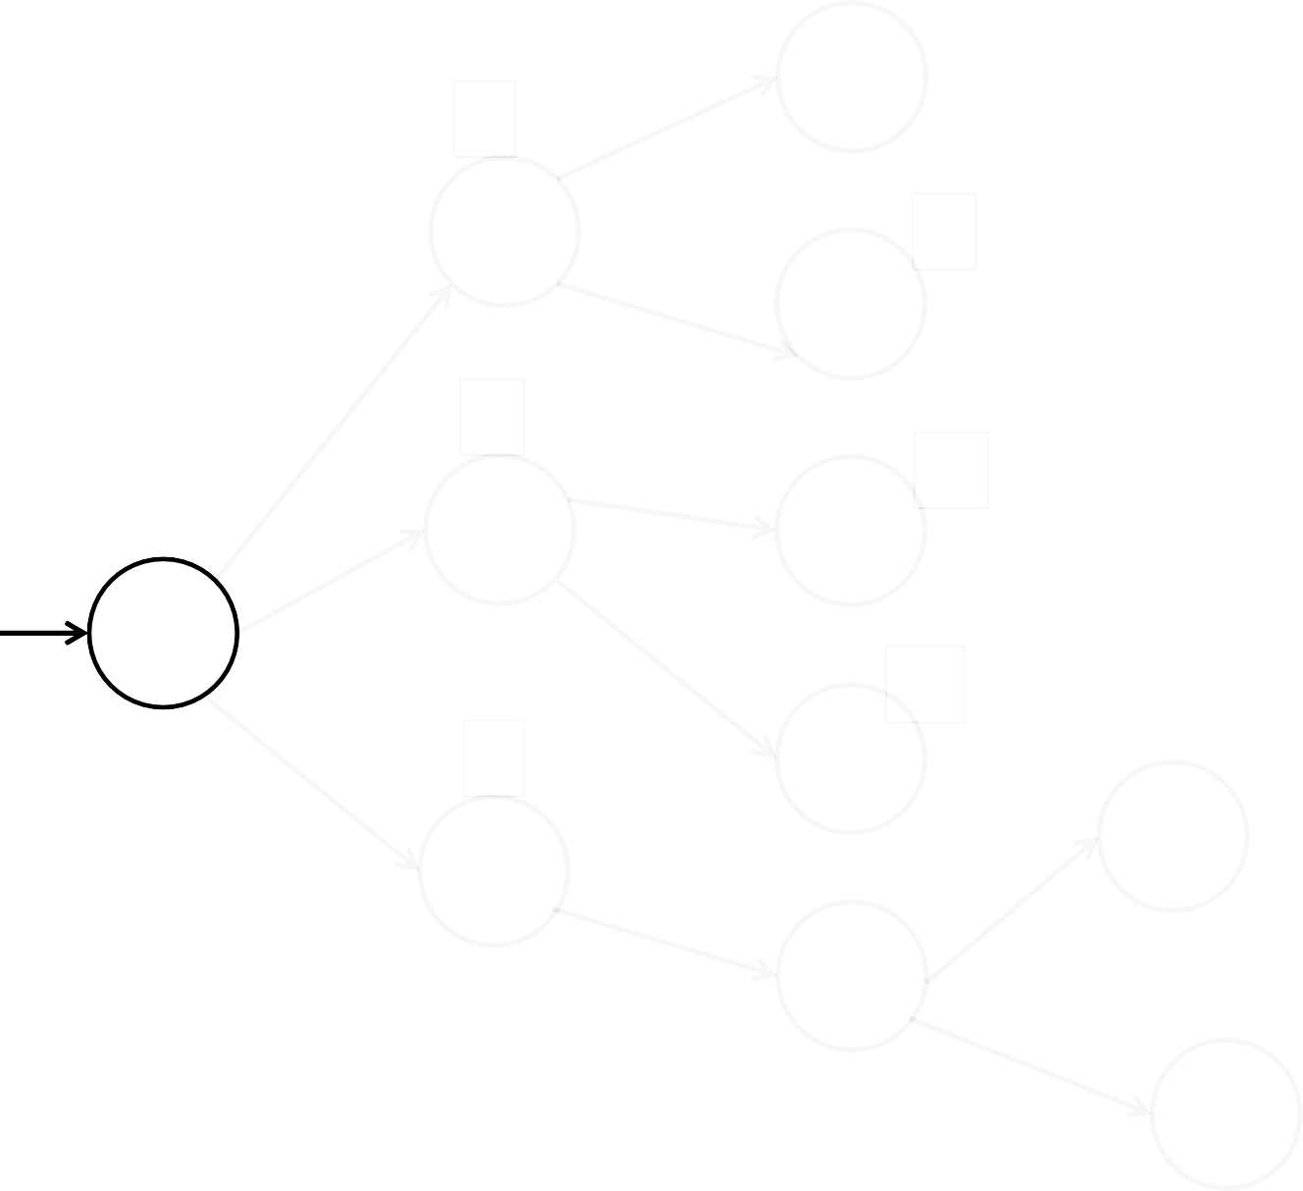

10
D
2
A
8
1
E
K
6
13
0
B
F
L
S
14
5
5
G
I
1
C
M
H
7
J
OPEN={ S}
CLOSED={}
6

Slide 42
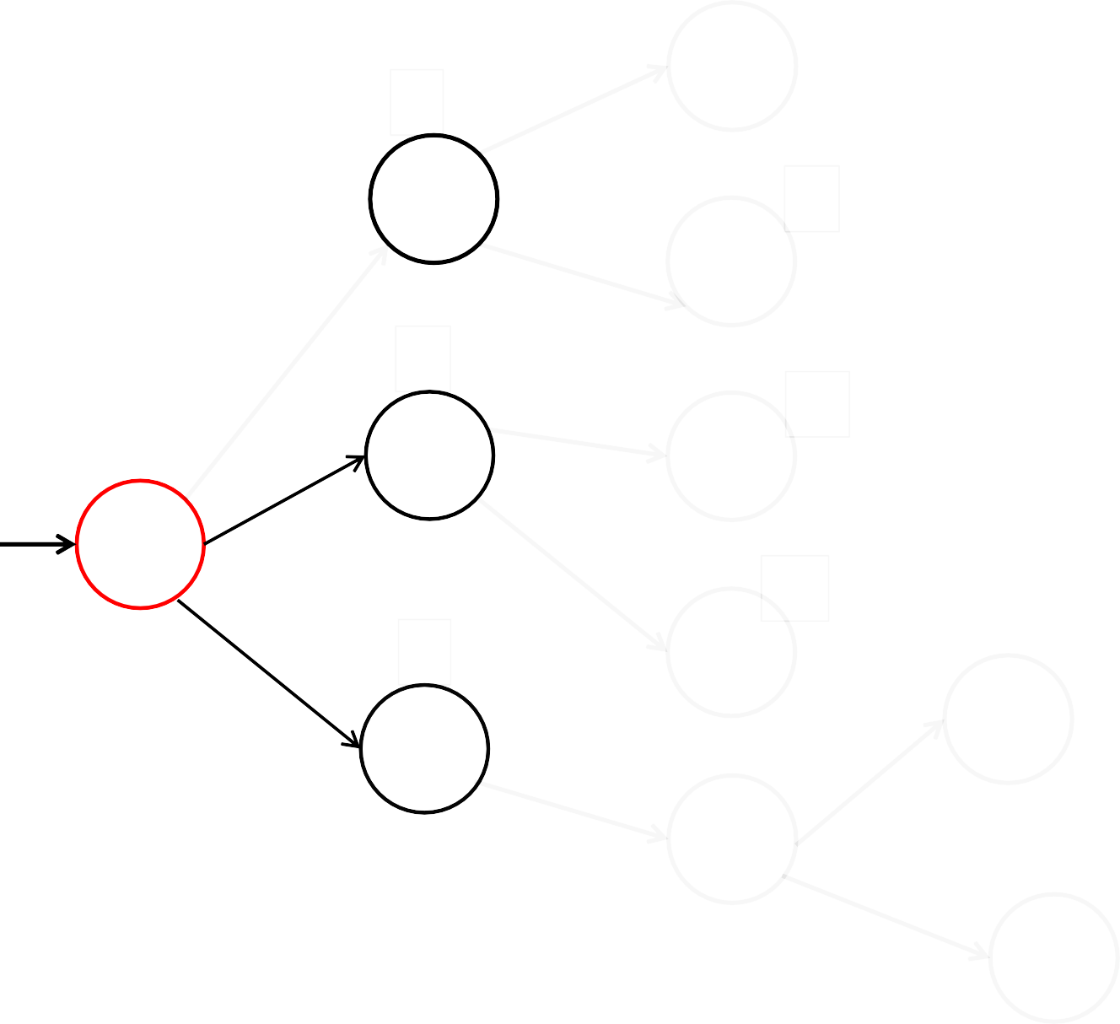
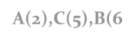
10
D
2
A
8
1
E
K
6
13
0
B
F
L
S
14
5
5
G
I
1
C
M
H
7
J
OPEN={ A(2),C(5),B(6)}
CLOSED={S}
6

Slide 43
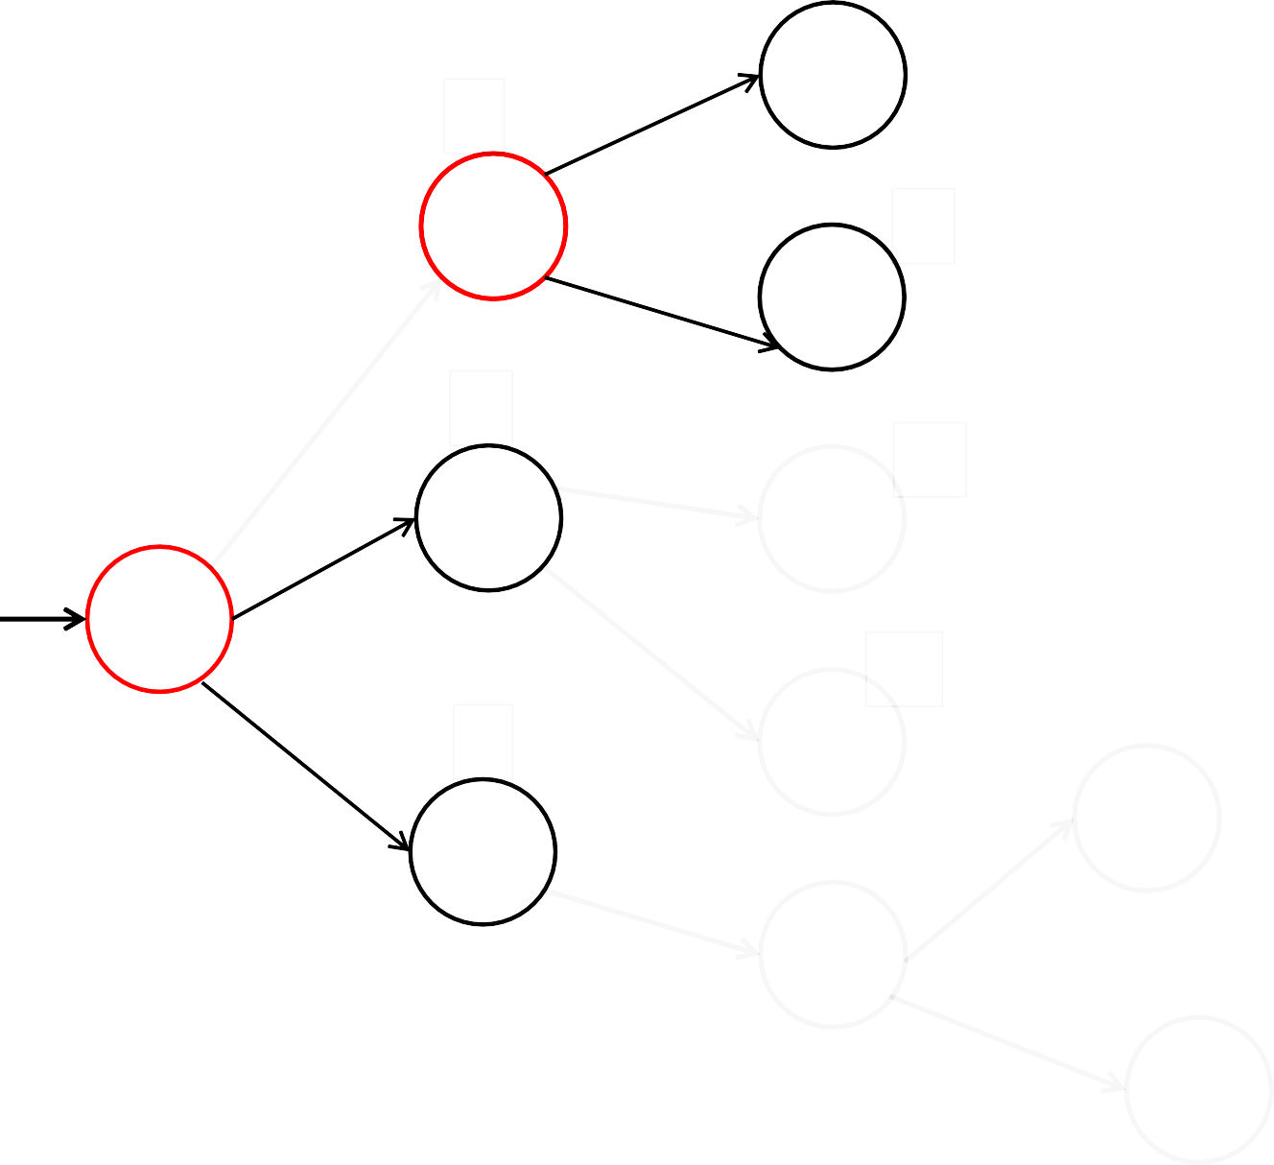
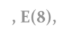
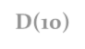

10
D
2
A
8
1
E
K
6
13
0
B
F
L
S
14
5
5
G
I
1
C
M
H
7
J
OPEN={ C(5), B(6), E(8), D(10)}
CLOSED={S,A}
6

Slide 44

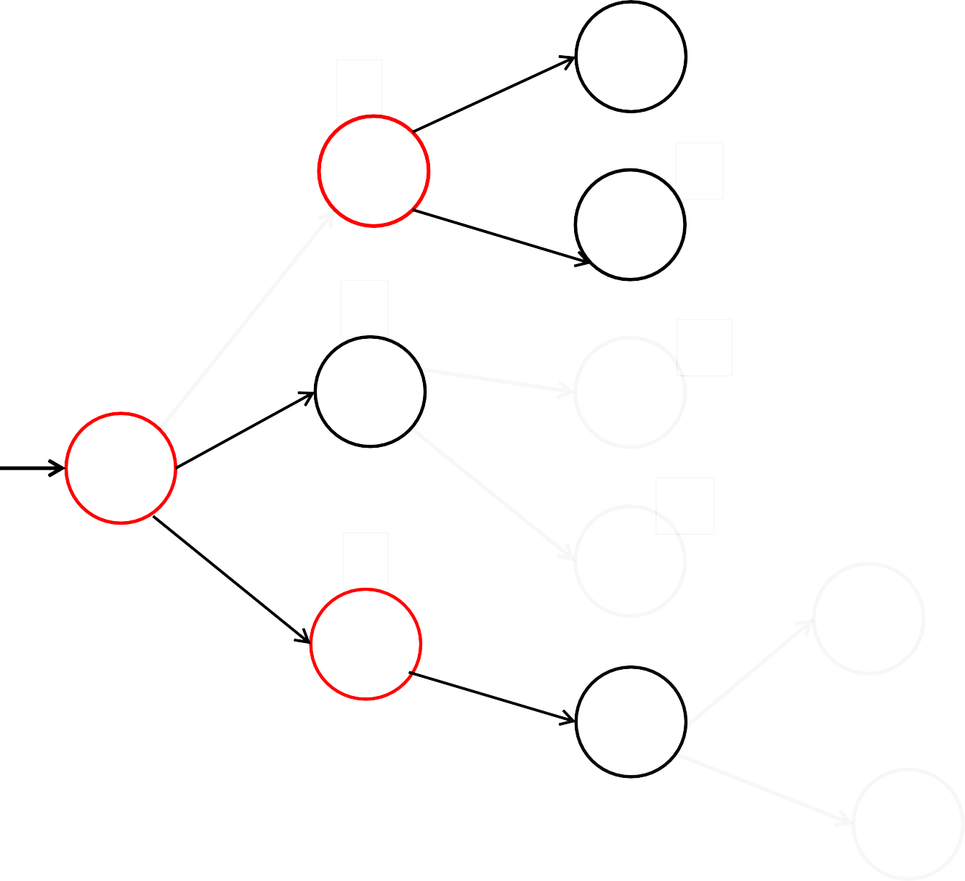
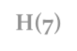

10
D
2
A
8
1
E
K
6
13
0
B
F
L
S
14
5
5
G
I
1
C
M
H
7
J
OPEN={ B(6), H(7),E(8), D(10)}
CLOSED={S,A, C}
6

Slide 45

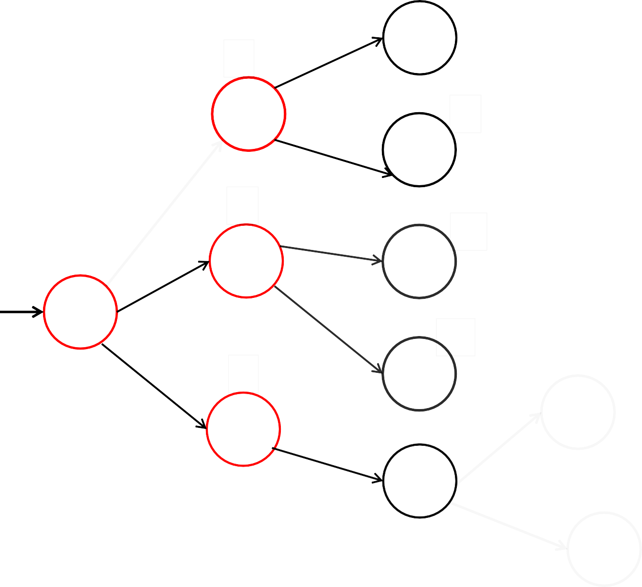
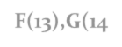

10
D
2
A
8
1
E
K
6
13
0
B
F
L
S
14
5
5
G
I
1
C
M
H
7
J
OPEN={H(7),E(8), D(10), F(13),G(14)}
CLOSED={S,A, C, B}
6

Slide 46

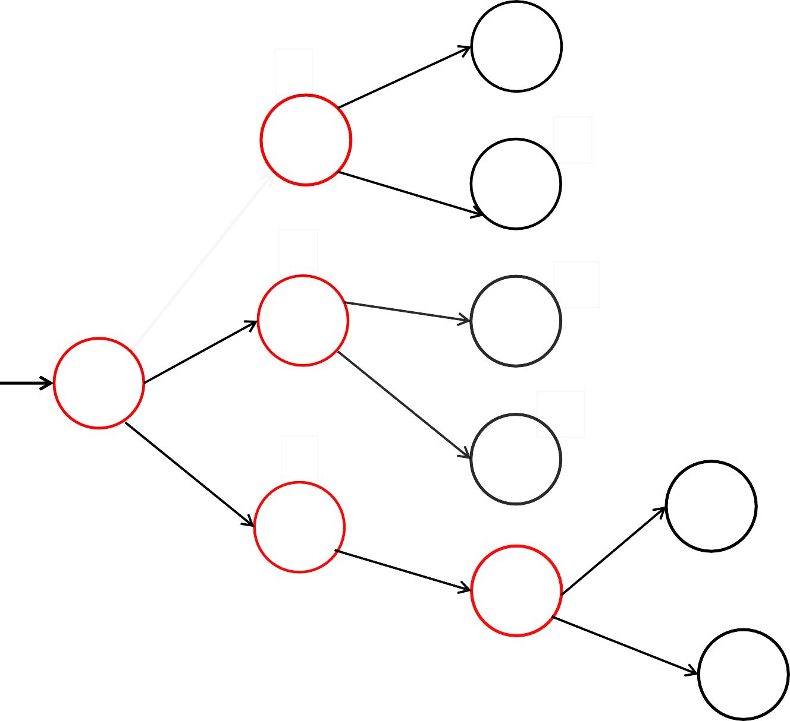


10
D
2
A
8
1
E
K
6
13
0
B
F
L
S
14
5
5
G
I
1
C
M
H
7
J
OPEN={I(5), J(6),H(7),E(8), D(10), F(13),G(14)}
CLOSED={S,A, C, B,H}
6

Slide 47

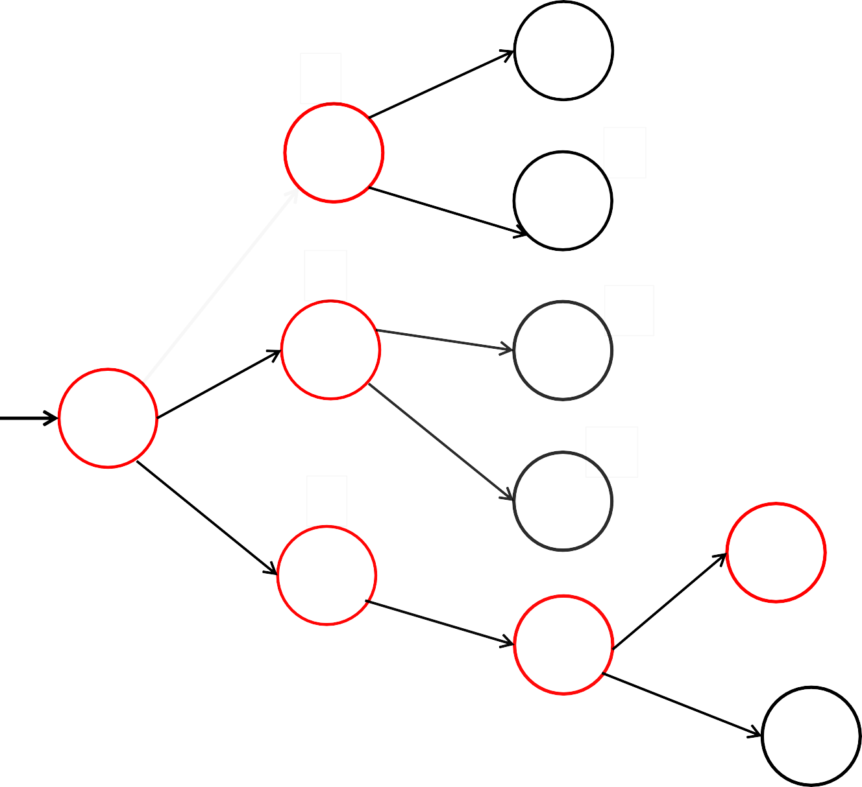
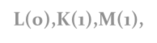

10
D
2
A
8
1
E
K
6
13
0
B
F
L
S
14
5
5
G
I
1
C
M
H
7
J
OPEN={L(0),K(1),M(1),I(5), J(6),H(7),E(8), D(10), F(13),G(14)6}
CLOSED={S,A, C, B,H,I}

Slide 48
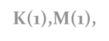

10
D
2
A
8
1
E
K
6
13
0
B
F
L
S
14
5
5
G
I
1
C
M
H
7
J
OPEN={K(1),M(1),I(5), J(6),H(7),E(8), D(10), F(13),G(14)} 6
CLOSED={S,A, C, B,H,I,L}

Slide 49
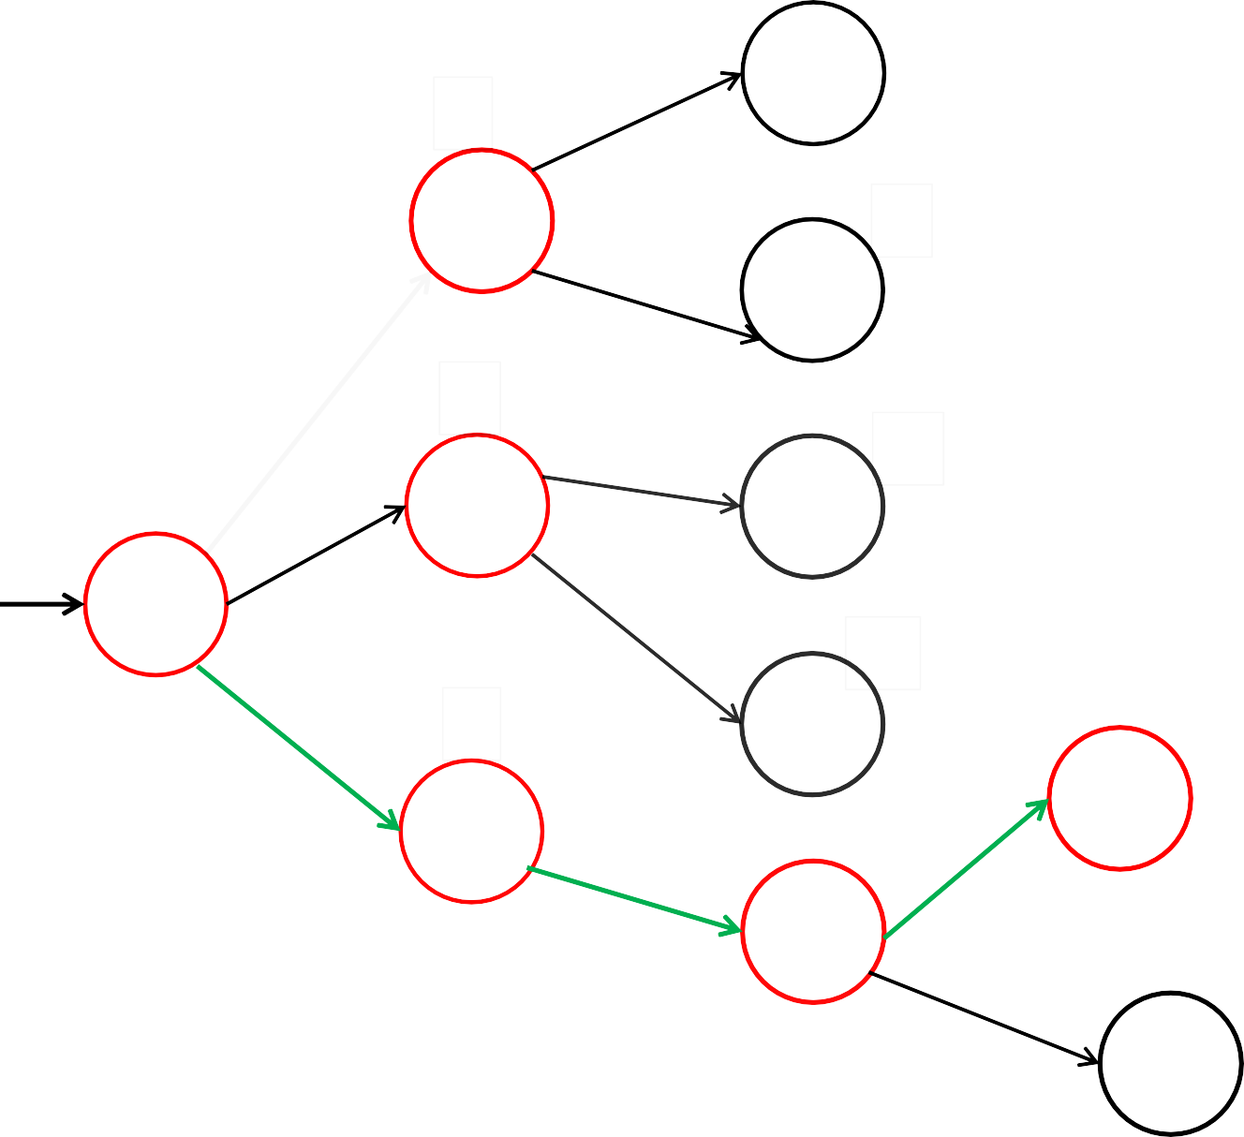
10
D
2
A
8
1
E
K
6
13
0
B
F
L
S
14
5
5
G
I
1
C
M
H
7
J
OPEN={K(1),M(1),I(5), J(6),H(7),E(8), D(10), F(13),G(14)} 6
CLOSED={S,A, C, B,H,I,L}
GOAL NODE FOUND!!

Slide 50

In Best First Search we jump all around in the search graph to identify the nodes with minimal evaluation function value.
Gives faster solutions but still no guarantee.

Slide 51
A* Algorithm
A* algorithm is similar to Best first Search.
Only difference: Best First Search takes h(n) as evaluation function/heuristic value.
In Best first search h(n)= estimated cost of current node ’n’ from the goal node.
A* takes the evaluation function as:
F(n)=g(n)+h(n)
where,
g(n)= cost(or distance) of the current node from start state.
h(n)= estimated cost of current node from goal node.

Slide 52

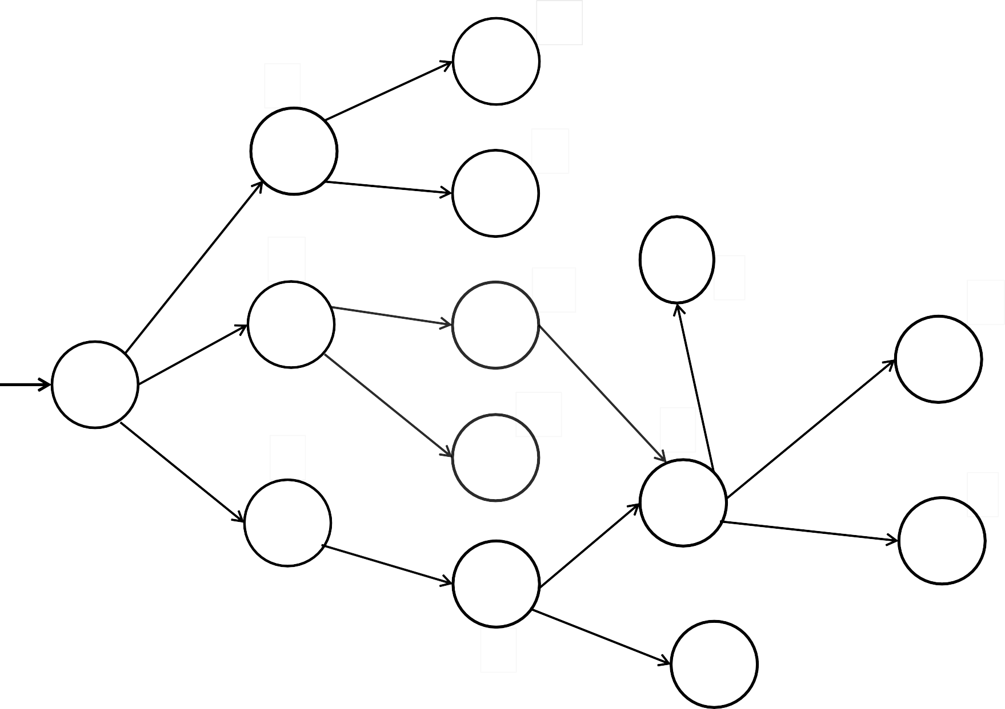
10
4
D
2
A
8
2
18
E
6
6
K
13
1
3
0
B
F
2
12
L
S
8
1
8
2
14
5
5
G
2
5
1
I
C
7
M
4
1
H
7
1
J
6

Slide 53

10
4
D
2
A
8
2
18
E
2
5
6
K
13
1
3
0
B
F
2
12
L
S
8
1
8
2
14
5
5
G
2
5
1
I
C
7
M
4
1
H
7
1
J
OPEN={S} CLOSED={}
6

Slide 54

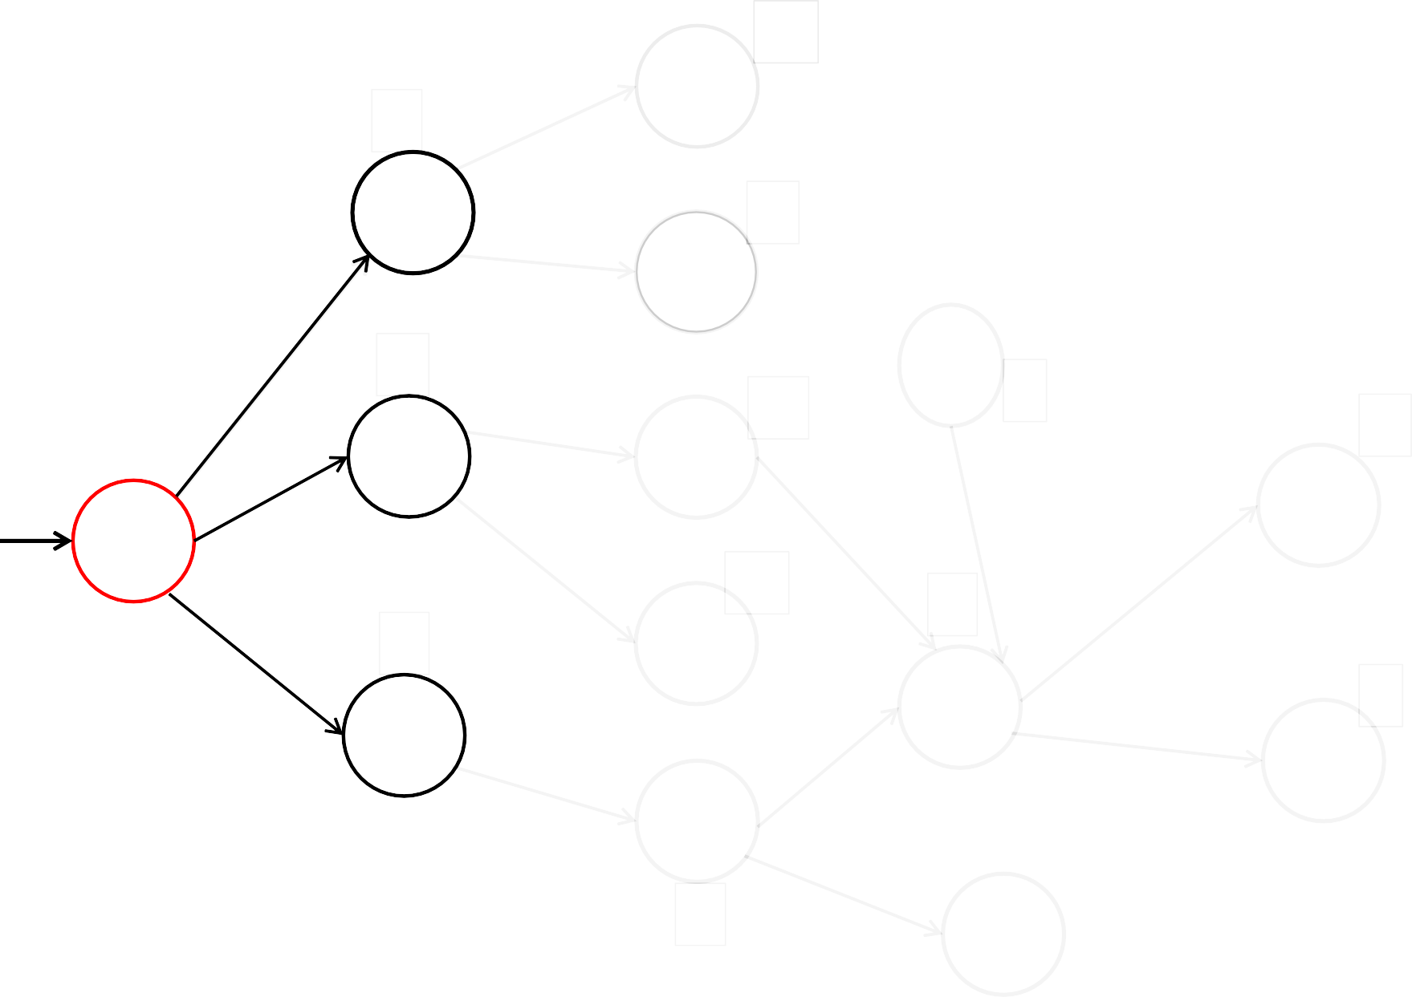
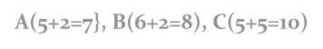

10
4
D
2
A
8
2
18
E
2
5
6
K
13
1
3
0
B
F
2
12
L
S
8
1
8
2
14
5
5
G
2
5
1
I
C
7
M
4
1
H
7
1
J
6
OPEN={A(5+2=7}, B(6+2=8), C(5+5=10)} CLOSED={S}

Slide 55

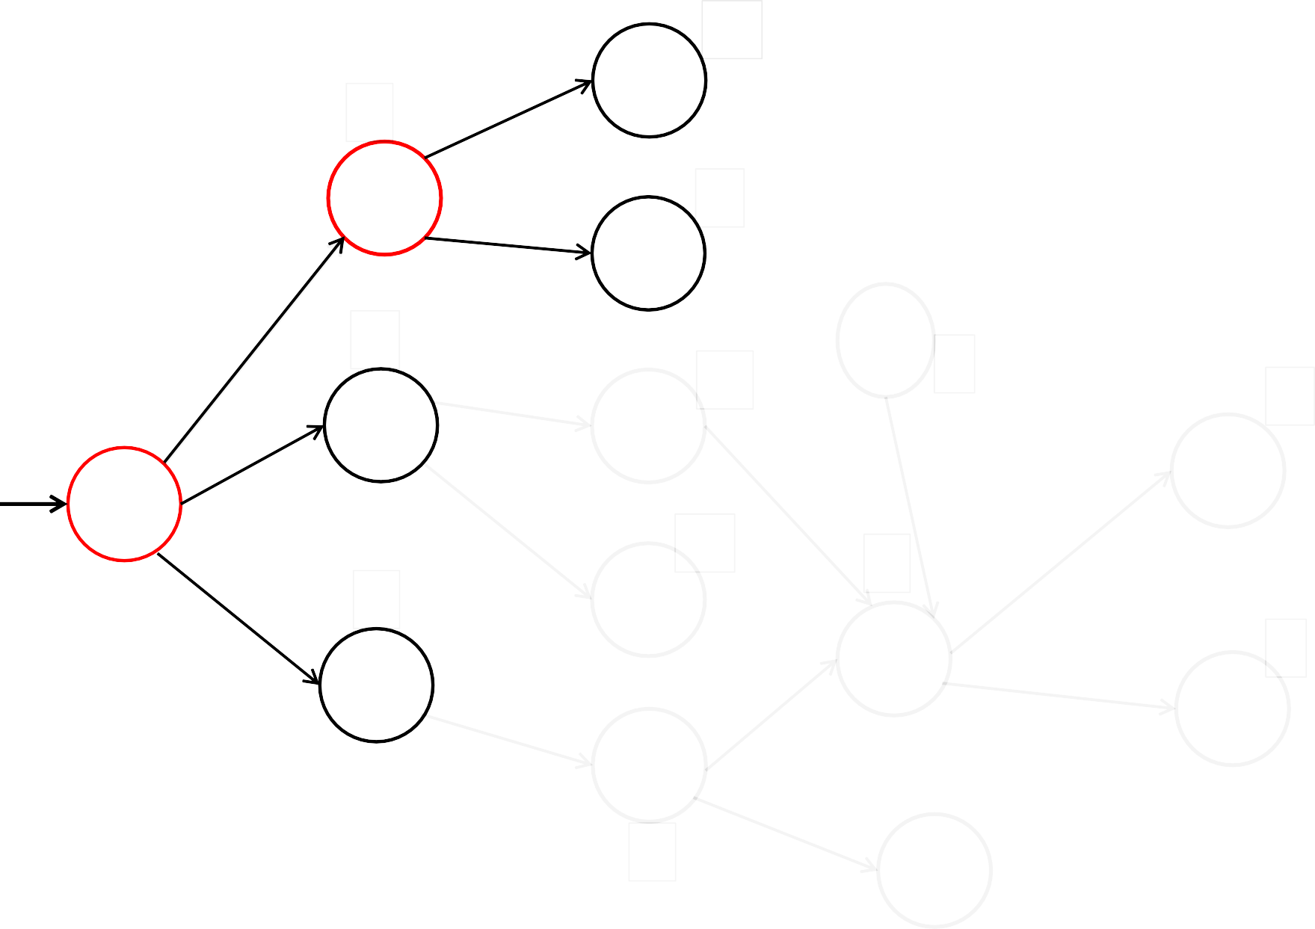
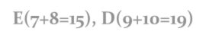

10
4
D
2
A
8
2
18
E
2
5
6
K
13
1
3
0
B
F
2
12
L
S
8
1
8
2
14
5
5
G
2
5
1
I
C
7
M
4
1
H
7
1
J
6
OPEN={B(8), C(10),E(7+8=15), D(9+10=19)} CLOSED={S,A}

Slide 56

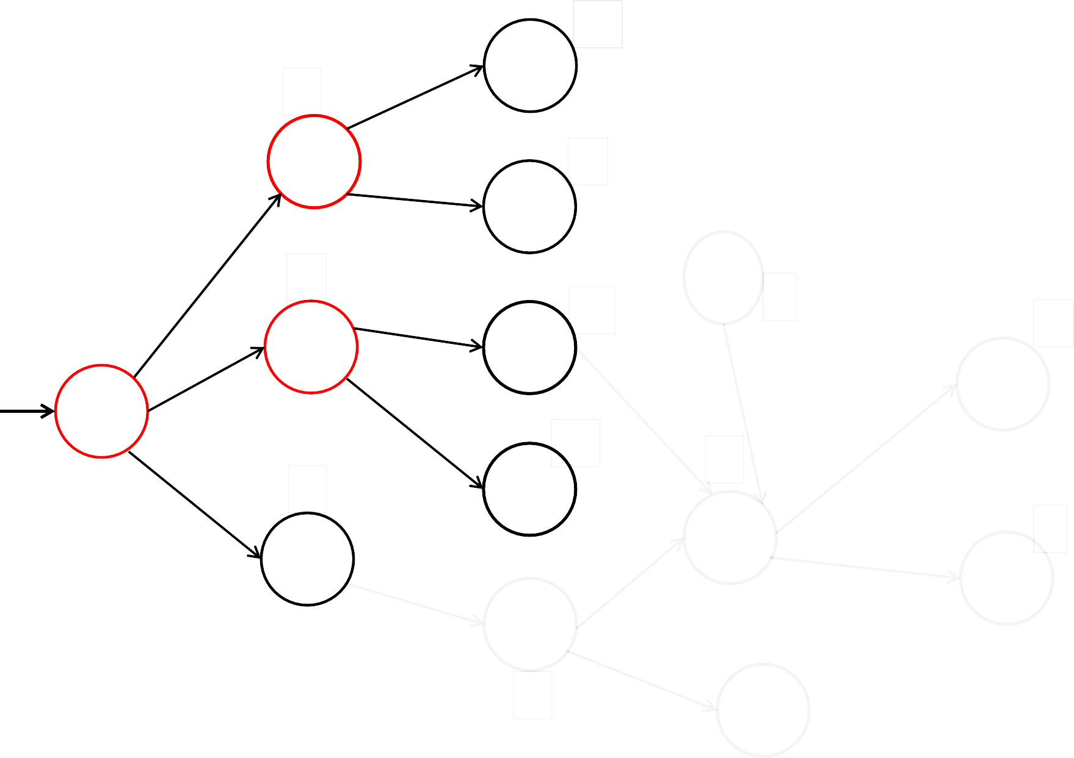
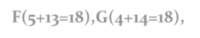

10
4
D
2
A
8
2
18
E
2
5
6
K
13
1
3
0
B
F
2
12
L
S
8
1
8
2
14
5
5
G
2
5
1
I
C
7
M
4
1
H
7
1
J
6
OPEN={C(10),E(15), F(5+13=18),G(4+14=18), D(19)} CLOSED={S,A,B}

Slide 57

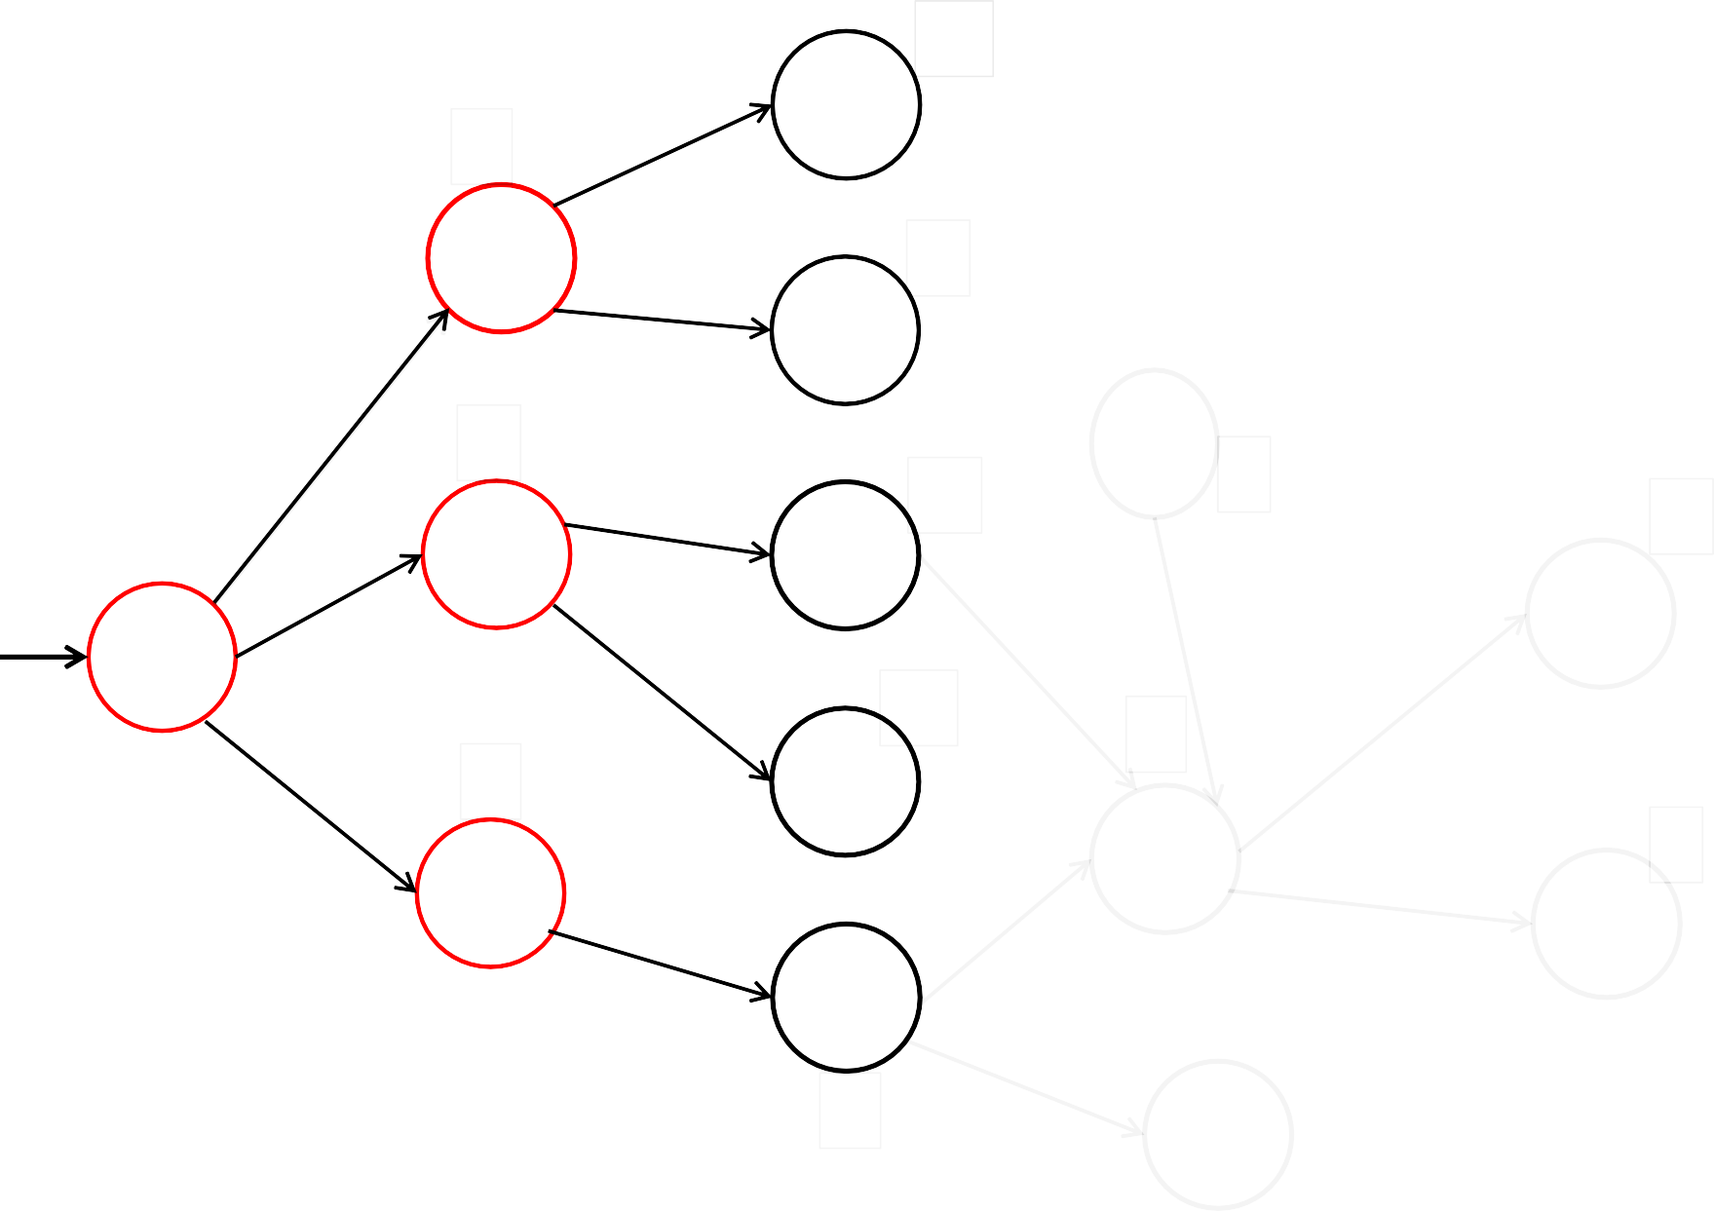
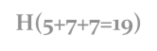

10
4
D
2
A
8
2
18
E
2
5
6
K
13
1
3
0
B
F
2
12
L
S
8
1
8
2
14
5
5
G
2
5
1
I
C
7
M
4
1
H
7
1
J
6
OPEN={E(15), F(18),G(18), D(19),H(5+7+7=19)} CLOSED={S,A,B,C}

Slide 58
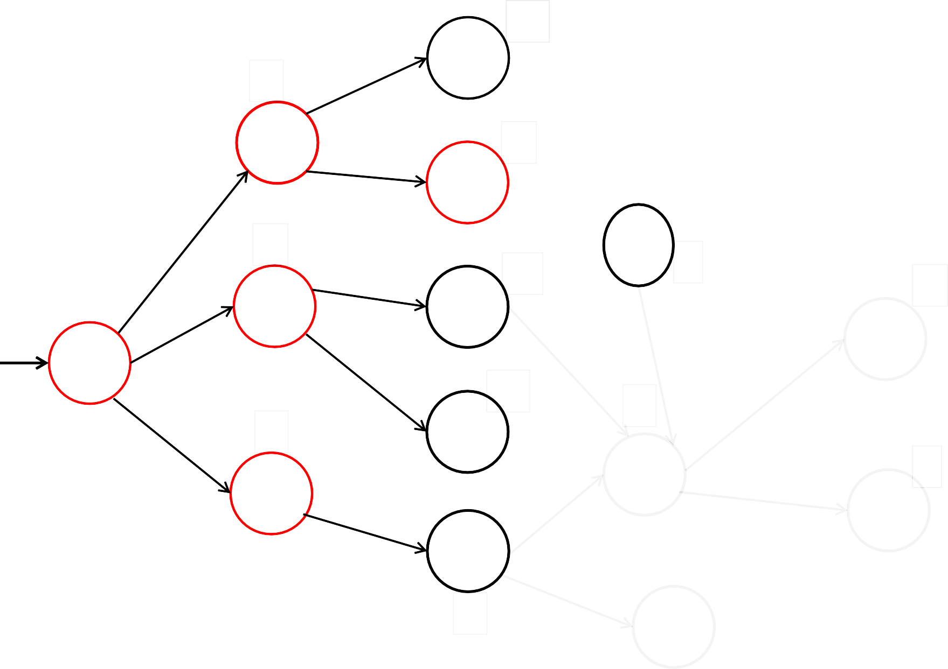
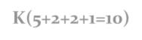

10
4
D
2
A
8
2
18
E
2
5
6
K
13
1
3
0
B
F
2
12
L
S
1
8
8
2
14
5
5
G
2
5
1
I
C
7
M
4
1
H
7
1
J
6
OPEN={K(5+2+2+1=10), F(18),G(18), D(19),H(19)} CLOSED={S,A,B,C,E}

Slide 59
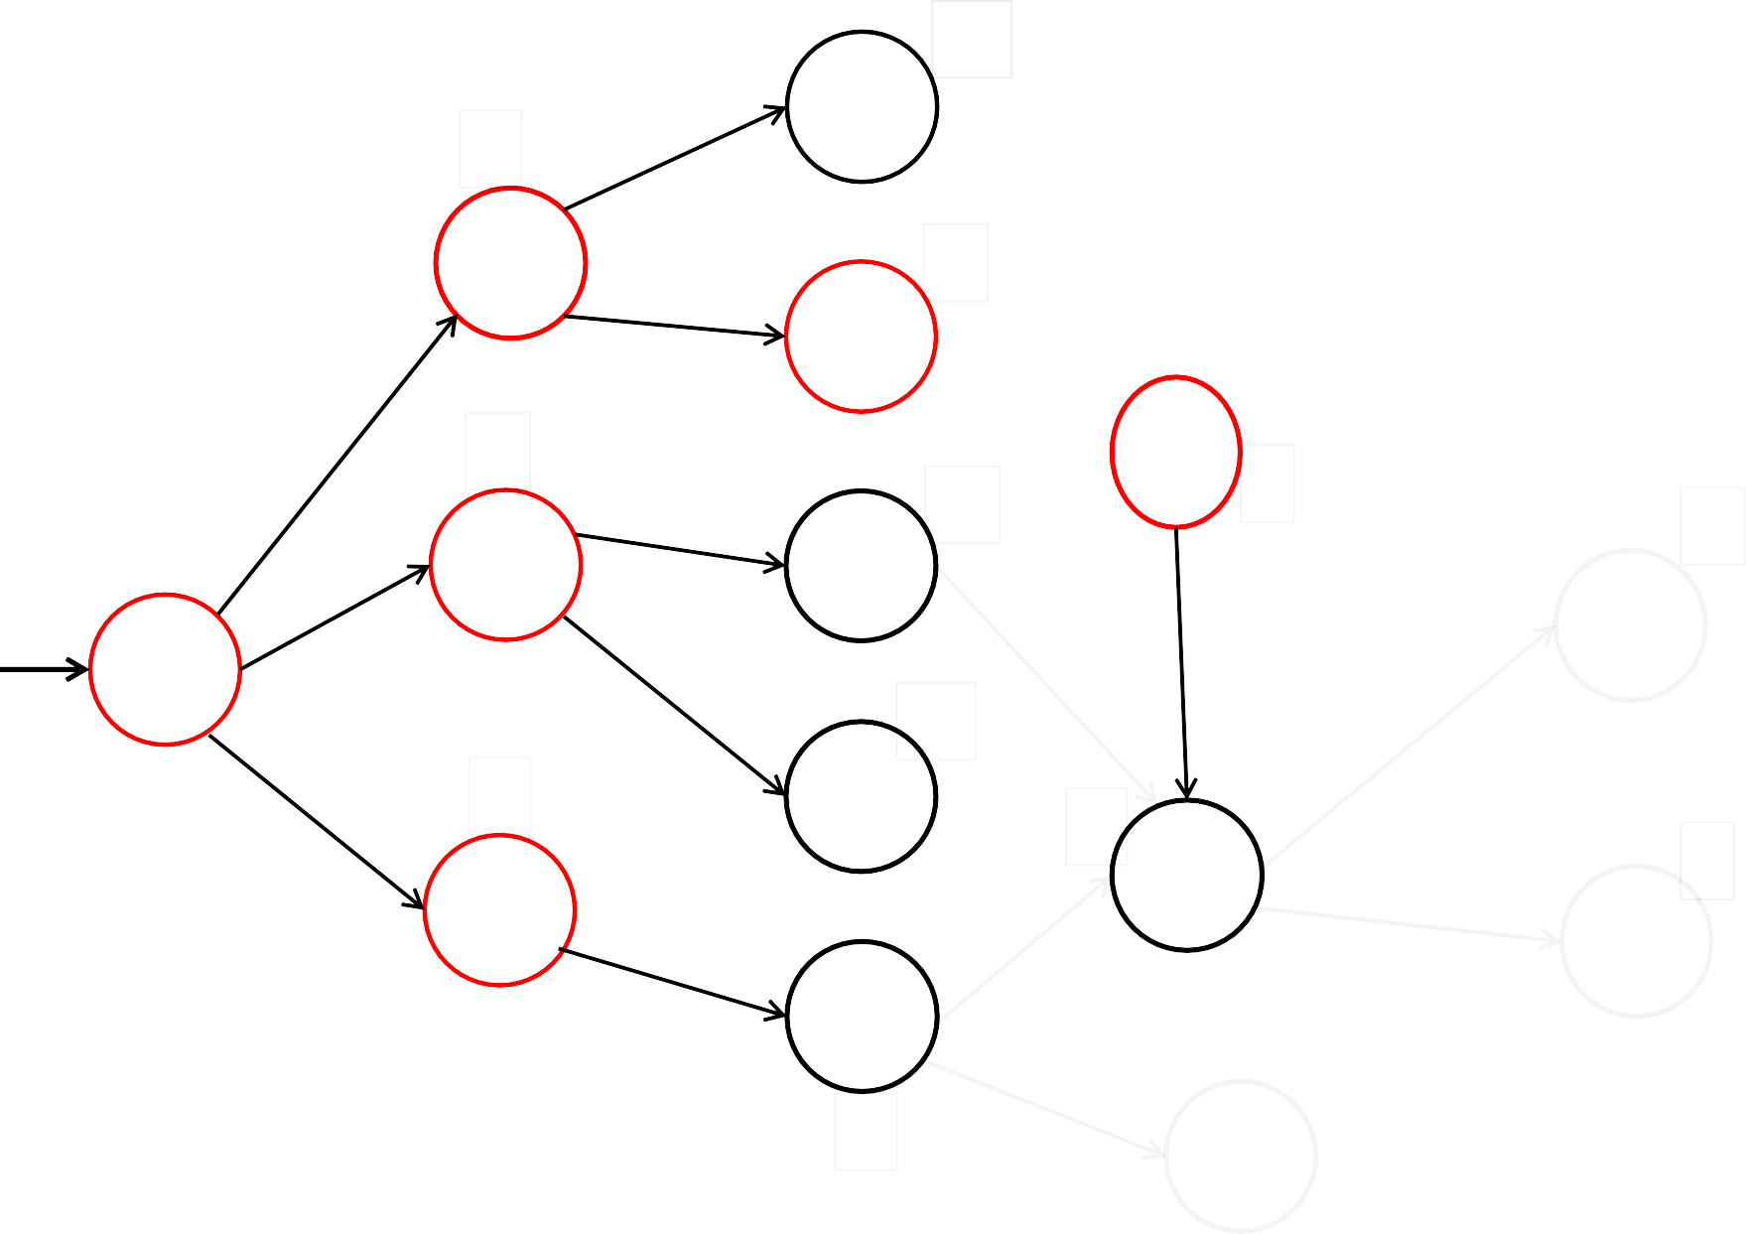
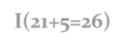

10
4
D
2
A
8
2
18
E
2
5
6
K
13
1
3
0
B
F
2
12
L
S
1
8
8
2
14
5
G
2
5
5
I
1
C
7
M
4
1
H
7
1
J
6
OPEN={ F(18),G(18), D(19),H(19), I(21+5=26)} CLOSED={S,A,B,C,E,K}

Slide 60

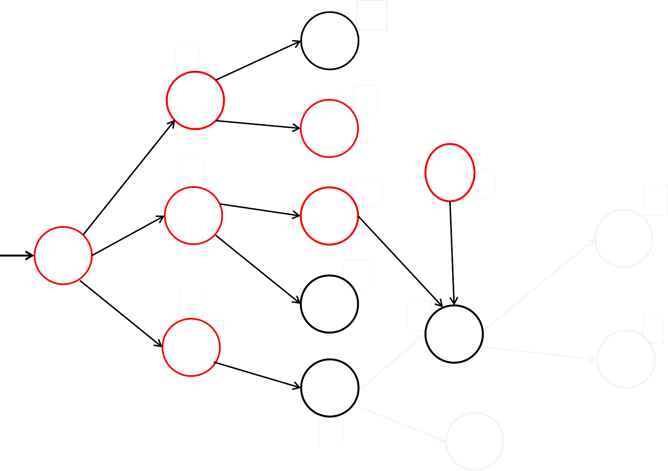
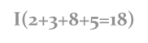

10
4
D
2
A
8
2
18
E
2
5
6
K
13
1
3
0
B
F
2
12
L
S
1
8
8
2
14
5
G
2
5
5
I
1
C
7
M
4
1
H
7
1
J
6
OPEN={ I(2+3+8+5=18),(F(18),G(18), D(19),H(19), I(26)} CLOSED={S,A,B,C,E,K,F}

Slide 61

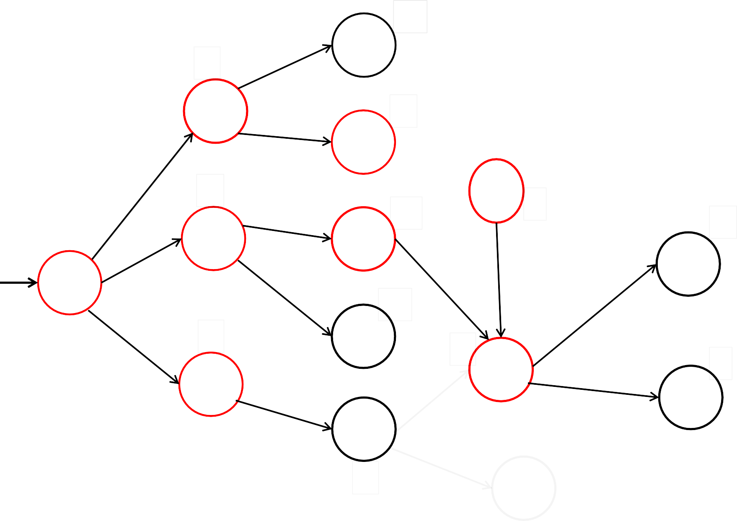
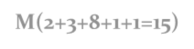
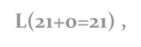

10
4
D
2
A
8
2
18
E
2
5
6
K
13
1
3
0
B
F
2
12
L
S
1
8
8
2
14
5
G
2
5
5
I
1
C
7
M
4
1
H
7
1
J
6
OPEN={ M(2+3+8+1+1=15),F(18),G(18), D(19),H(19),L(21+0=21) ,I(26)} CLOSED={S,A,B,C,E,K,F,I}

Slide 62
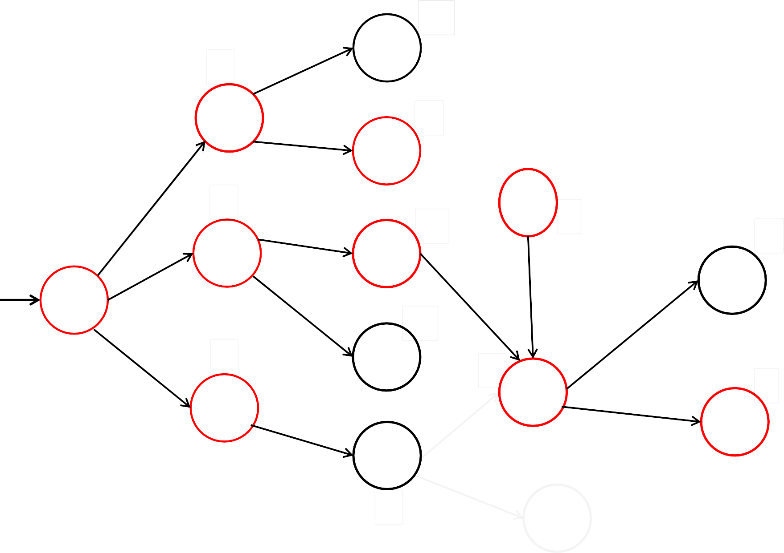
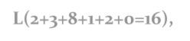

10
4
D
2
A
8
2
18
E
2
5
6
K
13
1
3
0
B
F
2
12
L
S
1
8
8
2
14
5
G
2
5
5
I
1
C
7
M
4
1
H
7
1
J
6
OPEN={ L(2+3+8+1+2+0=16), F(18),G(18), D(19),H(19),L(21) ,I(26)} CLOSED={S,A,B,C,E,K,F,I,M}

Slide 63

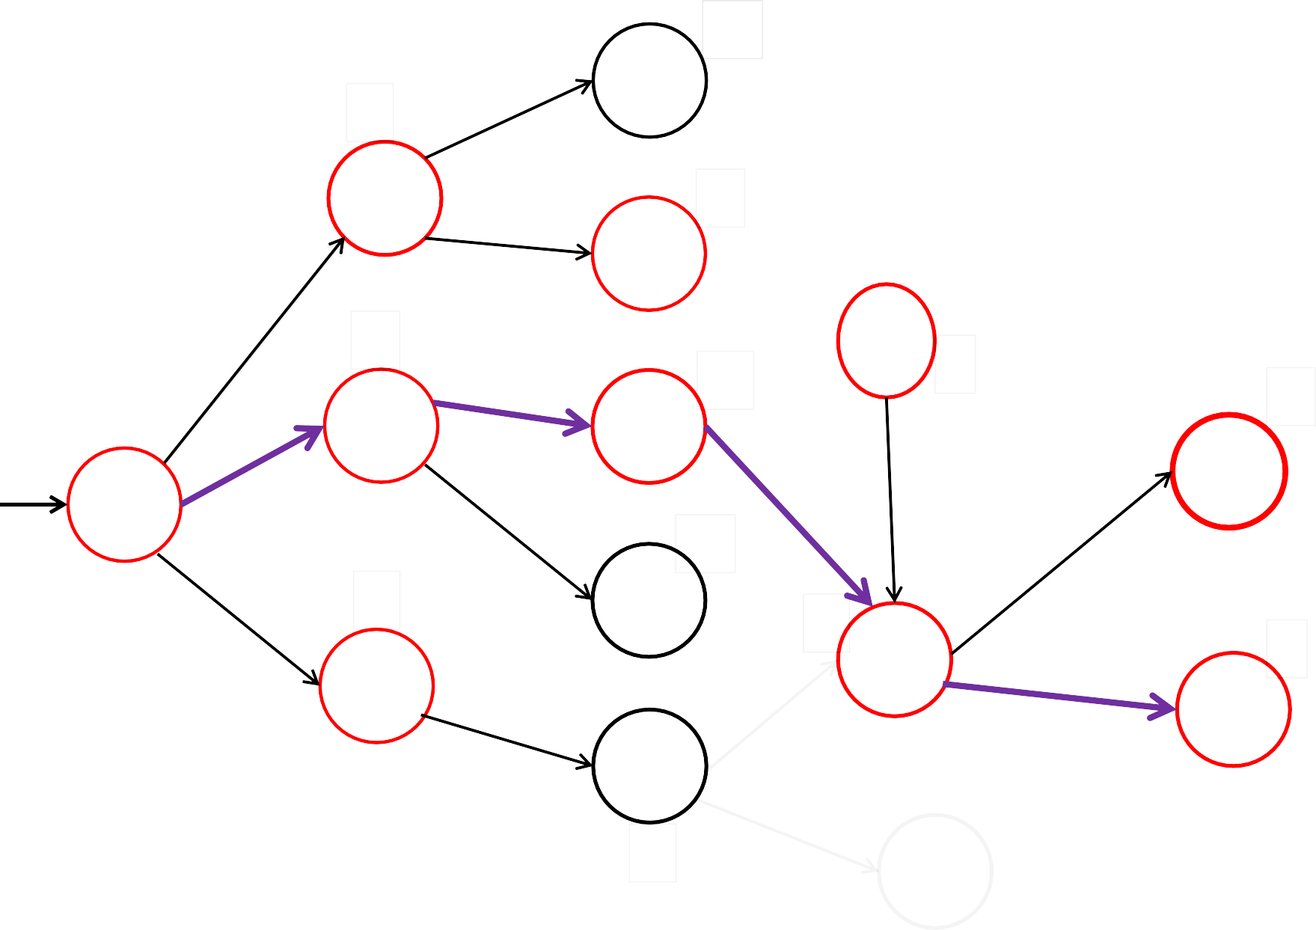

10
4
D
2
A
8
2
18
E
2
5
6
K
13
1
3
0
B
F
2
12
L
S
1
8
8
2
14
5
G
2
5
5
I
1
C
7
M
4
1
H
7
1
J
6
OPEN={F(18),G(18), D(19),H(19),L(21) ,I(26)} CLOSED={S,A,B,C,E,K,F,I,M,L}
GOAL FOUND!!

Slide 64

Problem Reduction and Decomposition (AND-OR Graphs)
Goal: Acquire TV
Goal: Steal a TV set
Goal: earn some money
Goal: buy TV set

Slide 65
Constraint Satisfaction Problem
Each state contains:
Variables X1,X2,X3,…….Xn Constraints C1,C2,…..Cn
Variables have to be assigned with values V1,V2,…..Vn Such that none of the constraints are violated.
Goal state- one in which all variables are assigned resp. values and those values do not violate any constraint

Slide 66

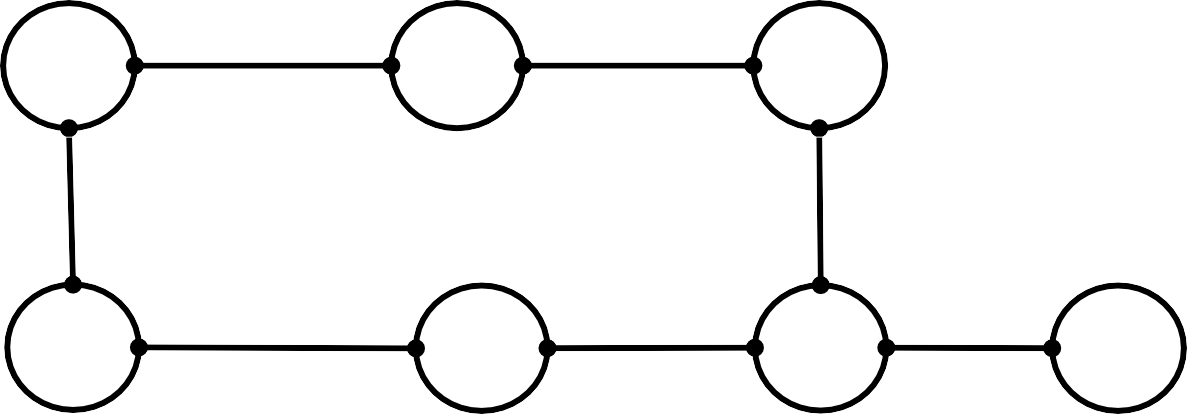
Example graph colouring problem
1
2
3
Variables: X1,X2,…….X7 Constraints: {red, green, blue}
4
5
6
8
7
1
2
3
8
4
5
6
7

Slide 67
Crypt Arithmetic
Constraints:
Variables: can take values from 0-9
No two variables should take same value
The values should be selected such a way that it should comply with arithmetic properties.
+ | T T | W W | O O
F | O | U | R

Slide 68


cannot be more
+ | C3 T T | C2 W W | C1 O O
F | O | U | R
STEP 1: C3 =1 since 2 single digit than 19 thus, |  | number | s plus a carry
C3=1 |  | F=1
Thus, |  | 1 T | C2 W | C1 O
 | + | T | W | O
 | 1 | O | U | R

Slide 69



 | 1 T | C2 W | C1 O
+ | T | W | O
1 | O | U | R
STEP 2:
T+T+C2 > 9 because only then it can generate carry. C2 can be 0 or 1 , depending on: if previous column is generating carry or not.
Assume:
C2=1
Then, 2T+1>9 So, 2T>8 hence T>4
Thus,
T can take value from 4,5,6,…9
Assume:
T=5

Slide 70



STEP 3:
1
5
5
1
W
C1
O
+
W
O
1
O
U
R
BUT , if T=5 , | T+T+C2=11 | which means O=1 !!! | CONSTRAINT
VIOLATED | as F=1.
GOBACK TO STEP 2 AND ASSUME DIFFERENT VALUE FOR T
We know , T can take value from 5,6,…9
Assume:
T=6

Slide 71
STEP 3:
1
5
5
1
W
C1
O
+
W
O
1
O
U
R
BUT , if T=5 , | T+T+C2=11 | which means O=1 !!! | CONSTRAINT
VIOLATED | as F=1.
GOBACK TO STEP 2 AND ASSUME DIFFERENT VALUE FOR T
We know , T can take value from 5,6,…9
Assume:
T=6

Slide 72



1
6
6
C2
W
C1
O
+
W
O
1
O
U
R
STEP 4:
T+T+C2 > 13 so,
O=3
Accepted till now
1
6
6
C2
W
C1
3
3
+
W
1
3
U R
O+O =R so, Since O=3, R=6 !!! VIOLATION as T=6
Hence T=6 cant generate Solution.

Slide 73



T=7
STEP 5:
Assume:
1
7
7
C2
W
C1
O
+
W
O
1
O
U
R
T+T+C2= 7+7+1=15
Thus, O=5
1
7
7
C2
W
C1
5
5
+
W
1
5
U R
O+O =R so, Since O=5, R= 0 and C1= 1
O=5
R=0
C1=1

Slide 74


1
7
7
C2
W
1
5
5
+
W
U
1
5 0
STEP 6: We have middle Column left i.e.
W+W+C1=U
Since C1 =1 W+W must be >9 [to generate carry] W>=5 To generate carry C2
W can take values 5,6,7,…9
Assume:
W=5
STEP 7:
Since W+W+C1=U if W=5 then,
5+5+1= 11 Thus U=1 !!! VIOLATION as F=1
W Cannot be 5 Repeat step 7.
thus

Slide 75


STEP 8:
Assume:
W=6
Since W+W+C1=U if W=6 then,
6+6+1= 13 Thus U=3 which is Accepted
U=3
THUS AT THIS STATE SINCE ALL THE VARIABLES HAVE BEEN ASSIGNED VALUES WHICH COMPLY WITH CONSTRAINTS GIVEN, WE HAVE REACHED FINAL STATE!!
1 | 1 | 1
7 | 6 | 5
+ ₇ | 6 | 5
1 ₅ | 3 | 0

Slide 76

 | C R | R O | O A | S D | S S
D | A | N | G | E | R

